Slide 1

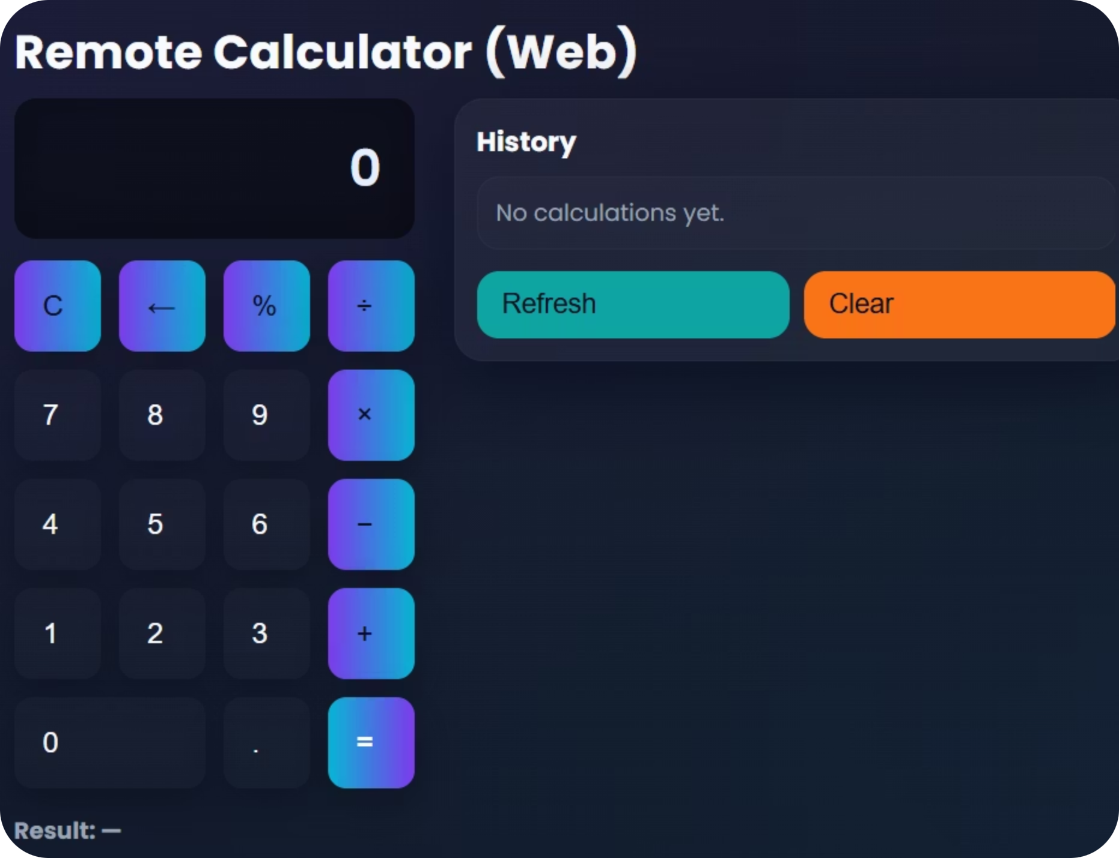
Remote Calculator: Socket CLI + Flask Web UI
Presented By: Nazmus Sakib
Student ID: 2102066 | Reg: 10193
B.Sc. CSE – 5th Semester
Date: 22/11/2025

Slide 2
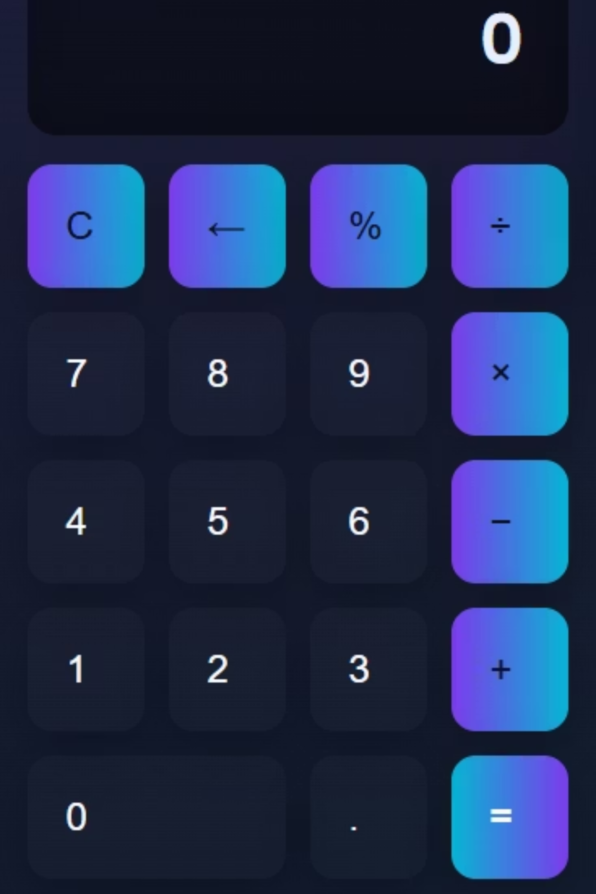
Problem Statement: Remote Calculation
Remote Calculation
Perform operations like "a operator b" remotely.
Float Support
Handle decimal numbers, returning integers when applicable.
User-Friendly Web UI
Provide a simple and intuitive web interface.
Session History
Maintain calculation history per browser session.

Slide 3

Challenges in Remote Calculation Systems
Developing robust remote calculation systems entails navigating complex hurdles in distributed computing. Successfully performing mathematical operations across a network demands careful consideration of data transmission, latency, and potential network failures.
Building reliable systems requires sophisticated error handling, data integrity checks, and a resilient architecture to ensure accuracy and continuous availability, making the design phase particularly intricate.

Slide 4


What I Built: Two Versions
TCP Version
Web Version
client.py: TCP client for direct interaction.
web_server.py: Flask backend for web requests.
server.py: TCP server, listening on port 7000.
index.html: Frontend Web UI for user interaction.
main.js: JavaScript for keypad logic and interactivity.

Slide 5
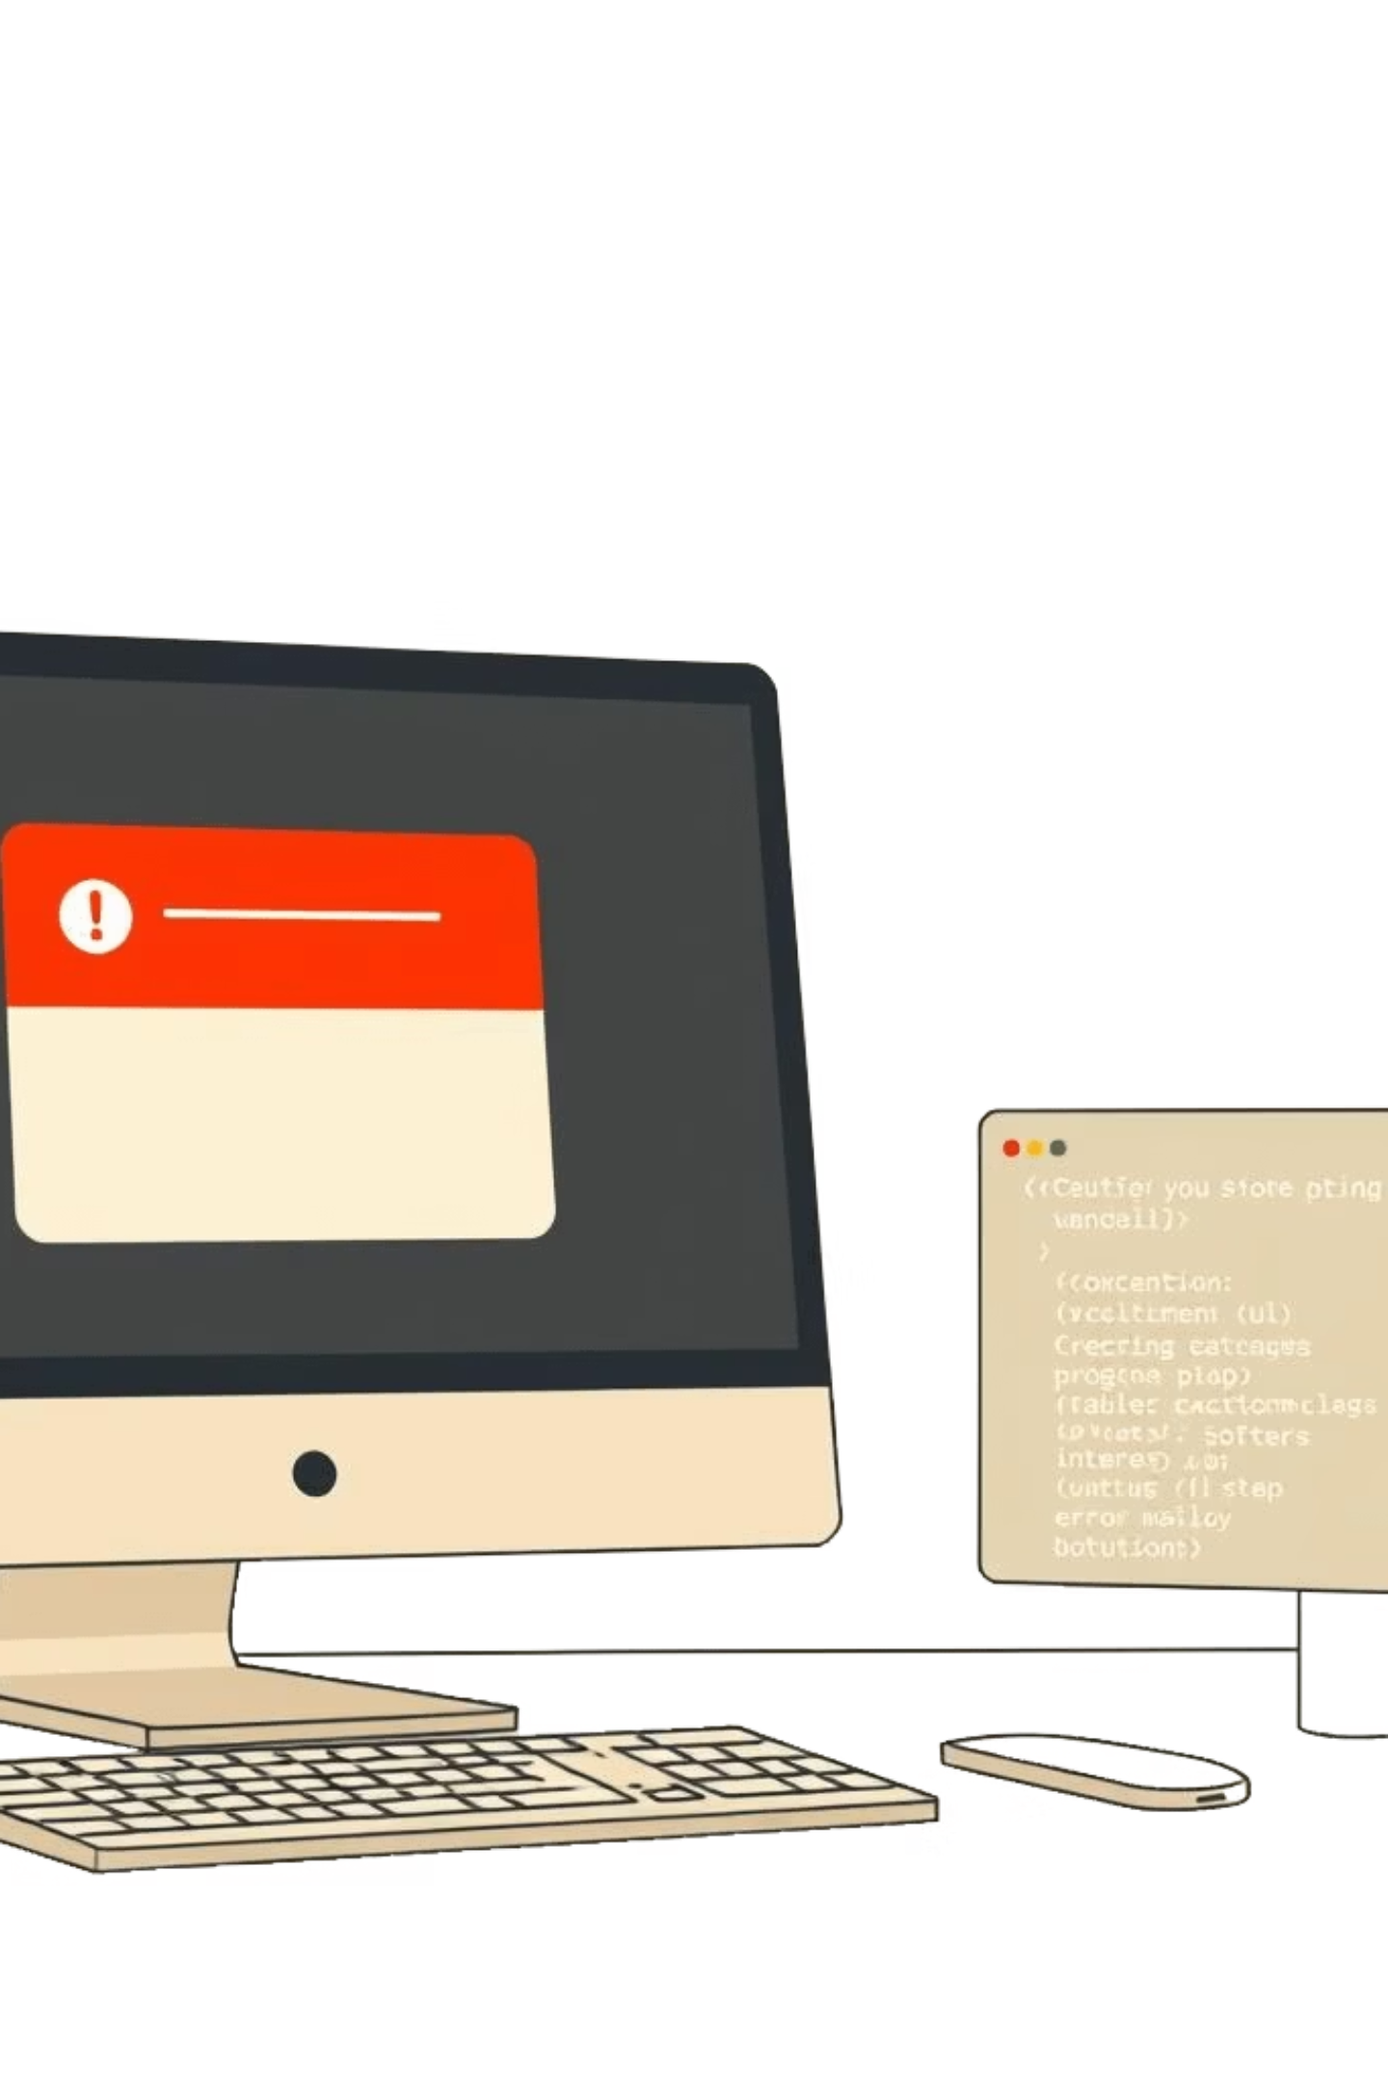
Calculation Logic: Precision & Error Handling
Supported Operations
Float & Integer Output
Includes +, -, *, /, and % for comprehensive calculations.
Computes in float, but returns integer if result has no decimal.
Error Handling
JSON-formatted errors for invalid input or divide-by-zero scenarios.

Slide 6


Web API & Session Management
Key Endpoints
Session Management
POST /api/calc: Performs calculations.
Flask signed cookie stores the last 20 entries per browser, ensuring session-based history.
GET /api/history: Retrieves session history.
POST /api/history/clear: Clears history.
POST /shutdown: Secure development shutdown.

Slide 7


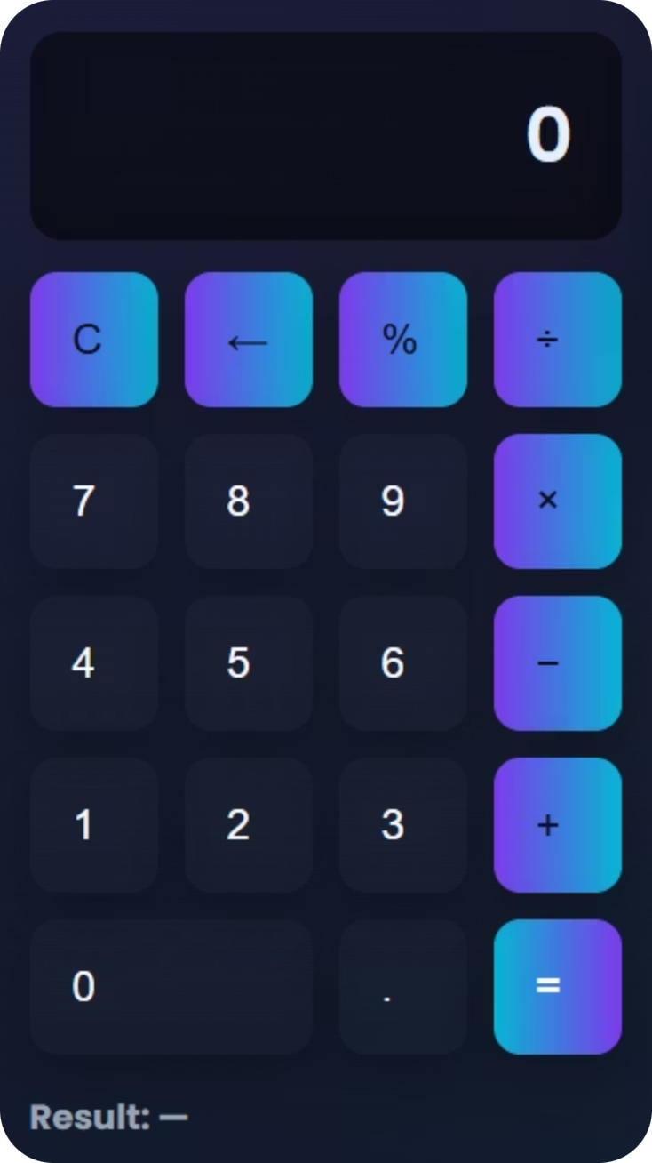



Frontend UI: Intuitive Design
Mobile-Style Keypad
Familiar layout for easy input.
Display & Controls
Clear, backspace, and result display functions.
Operator Chaining
Seamlessly link multiple operations.
Dark/Light Theme
User-selectable visual preference.

Slide 8

Live Demo: Running the Calculator
1
2
Run Backend
Open Browser
Set environment variables and execute python web_server.py.
Access the application at http://127.0.0.1:5000/.
$env:REMOTE_CALC_SECRET="change-me"$env:REMOTE_CALC_SHUTDOWN_TOKEN="dev-token"python web_server.py
3
4
Demo Operations
Shutdown (Dev Only)
Test calculations: 7 + 5 → 12, 7 / 2 → 3.5, 7 / 0 → error.
Use a POST request with the specified token to shut down.
Invoke-RestMethod -Method Post -Uri "http://127.0.0.1:5000/shutdown" -Body '{"token":"dev-token"}' -ContentType 'application/json'

Slide 9





Implementation Notes: Design Choices
Flask Sessions
Utilised for history, eliminating the need for a database.
TCP Server Retention
Maintained for assignment compatibility requirements.
Float Computation
Calculates with floats, formatting integer-like results cleanly.
Extensibility
Code designed for future integration with SQLite or Redis.

Slide 10


Limitations & Next Steps
Current Limitations
Future Improvements
Session-only history.
Persistent history (SQLite/Redis).
Partial keyboard support.
Full keyboard support & enhanced accessibility.
Accessibility (ARIA) improvements needed.
WSGI + HTTPS deployment for production.
No production deployment.
Removal of dev shutdown endpoint.

Slide 11
Thank You

